Slide 1

The new world of strategic planning
HBF Planning Conference, 9th September 2026
Catriona Riddell BA (Hons) Planning FRTPI

Slide 2
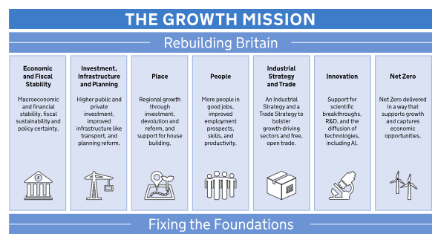


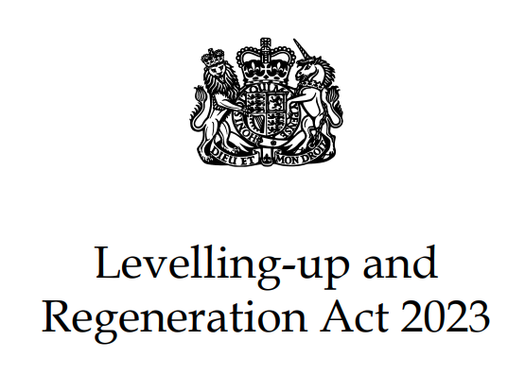

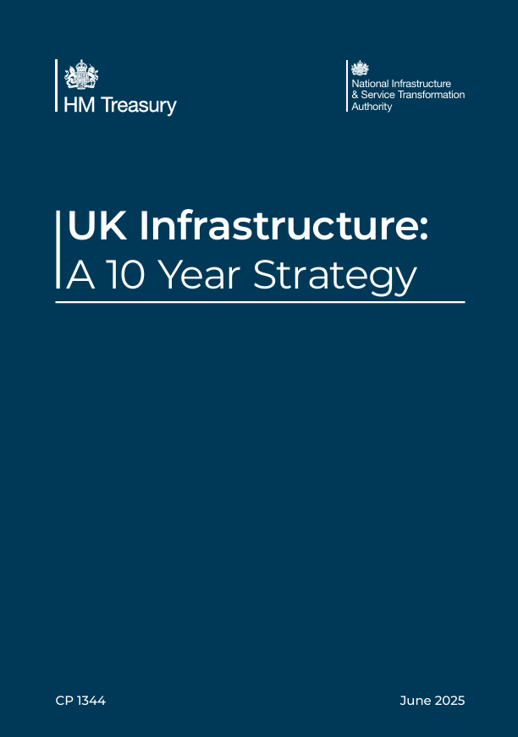


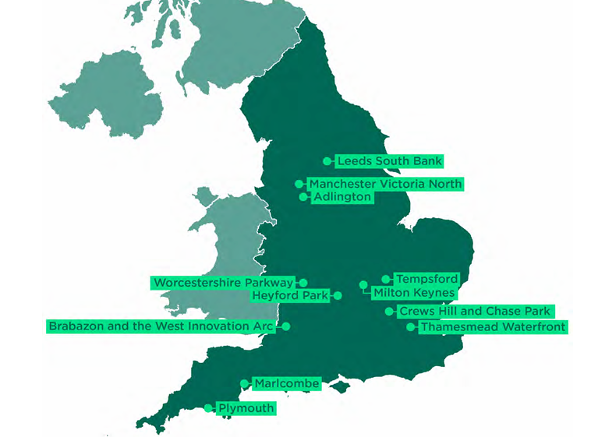




Devolution and strategic planning – the national context
Fixing the plan-led system is key to the Government’s growth mission – providing more certainty for communities, applicants and investors.
Re-introducing a two-tier Development Plan system is aimed at reducing risks and building more stable conditions for investors – public, private and others.
It aims to provide a more robust approach to place-based growth, integrating long term economic, environment and social priorities with development and infrastructure.

Slide 3

Devolution and strategic planning – the national context
“I am going to give Britain the circuit-breaker it needs, by building a more collaborative politics in Westminster, by taking power out of the centre and putting it in the hands of the people and places who can use it best and, in so doing, creating a new sense of agency, possibility and hope flowing around the country….
I will reach out to other political parties to find as much common ground as we can and build that more collaborative approach I spoke about a moment ago. So, a greater sense of unity in Parliament will then allow us to give a clearer sense of direction to Whitehall…..
The change will be the biggest change in our lifetimes to the way the country is run and it is consistent with the 2024 manifesto. We will create a more streamlined state with a clearer purpose: to power up all parts of the country and put a laser-like focus on growth and regeneration. Good growth……
On utilities, we will ensure all parts of the UK are able to take greater public control of essential services like water, housing, energy and transport……
Britain’s housing crisis is having a ruinous impact on its public finances. So, working with local areas, No 10 North will oversee the biggest council house building programme since the post-war period. We will use public land, vacant public land to reduce costs.”
Andy Burnham MP, 29th June 2026
“Place-first, not party-first”
“Problem-solving, not point-scoring”
“Long-term, not short-term”

Slide 4
The new ‘plan-led’ system
The Statutory Development Plan
Decision-making
More national standardised polices to ensure consistency (NPPF) – not to be repeated in LPs
More support for delivery e.g.
Mayoral funding through Devolution
Targeted action on stalled strategic sites (ATLAS)
Homes England Place Partnerships
Spatial Development Strategies
Reintroduction of a strategic plan at sub-regional scale (PIA)
National Decision-making policies
Local Plans/ Minerals & Waste Plans
New ‘vision-led’ local plan system with statutory timetable and streamlined (LURA)
Modernising Committees (including National Scheme of Delegation)
Reduced need for Member approval because of up-to-date LPs and increased engagement at plan-making stage (PIA)
Neighbourhood Plans/ Supplementary Plans
NPs retained and new statutory SPs introduced (LURA)
Mayoral planning powers
New planning powers to support delivery of strategic priorities set out in the SDS (EDCE Act)
Engagement in the planning process

Slide 5
A new era of strategic planning
SDS will provide integrated, high level spatial investment frameworks –They will have to provide the spatial articulation for other ‘place-based’ plans and strategies, especially Local Growth Plans. They will not allocate sites.
The Legal framework is now in place through the Planning & Infrastructure Act but waiting for secondary legislation/regs (including statutory underpinning for new Strategic Planning Boards) & PPG.
SDS will be part of the statutory development plan and local plans will therefore have to be ‘in general conformity’ with the SDS.
SDS will be ‘vision-led’ and outcome focused and will therefore have to reflect the shared ‘place-based’ vision and ambition of LA partners (or Strategic Authorities).
SDS will be long term, with the strategy setting the distribution of growth for 25+ year period, including LP housing targets, setting ‘general extent’ of Green Belt (where relevant), identifying ‘investable pipeline’ of strategic infrastructure and strategically important growth areas.
New Strategic Planning Authorities (SPAs) will be legally designated – Different in different places but new Prime Minister may drive devolution forward quicker.
Funding agreed for 2026-29 - first tranche of funding has been allocated to most emerging SPAs.
SDS to be ‘digitally enabled’ with opportunities to use data and digital tech throughout all stages of the process.
Spatial development strategies should set a positive vision for future growth and change at a sub-regional scale and provide a clear spatial framework for investment and growth, including for new housing. Their content should be genuinely strategic in nature and allow for more detailed issues to be considered and addressed through other parts of the development plan.
Policy PM1, NPPF

Slide 6
A new era of strategic planning
Need to keep SDS strategic and not become ‘big local plans’, especially if we are to get first generation in place quickly – no red lines on maps!
SDS will be evidence supported, not evidence led. Intelligent commissioning will be essential, as will careful thinking around joining up current visions for growth – for SDS area and neighbouring areas if relevant.
A ‘Plan, Monitor, Manage’ approach will be needed given that these are supposed to be transformational frameworks delivered over time, with different market/funding/policy conditions impacting. Push to have a national ‘Outcomes Monitoring Framework’ to support this. And this means….
The testing process will be different to local plans, especially around ‘deliverability’. It will be important that viability test is not applied as these are long term plans and range of new tools and funding will impact on delivery. Implementation and Monitoring Frameworks will provide key evidence at Examination.
Engaging local communities on strategic issues will be important but challenging -different tools need to be used e.g. digital engagement, community panels.
A different resource is needed to local planning with a very different skillset – planners will be needed but as part of multi-disciplined team.
“It is important to stress that SDSs are not big local plans. They cannot be site-specific or allocate/designate particular sites. The site-specific role is preserved for local plans, which will have to be in ‘general conformity’ with the SDS once it has been adopted. The government does not intend to set a limit or range on the size or length of SDS, but they are expected to be succinct and not get into detail or locally specific issues.”
Areas for producing spatial development strategies - GOV.UK

Slide 7
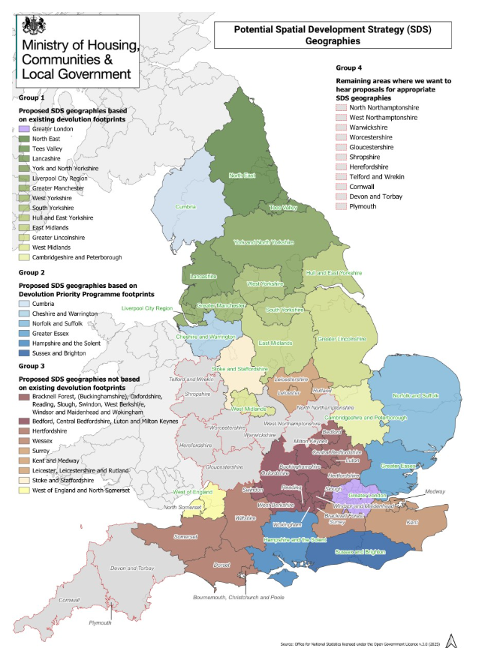
A new era of strategic planning
Sequencing will be challenging initially in areas where local plans are being prepared and where there are newly adopted local plans. Any strategic sites currently being planned for/ delivered will have to be taken into account in emerging SDS spatial strategy.
Engaging infrastructure providers and agencies at the start will be vital - especially in relation to infrastructure for the long term (e.g. water and energy) – need to get decisions made at plan-making stage instead of application stage.
Partnerships will play an important role in both SDS preparation and delivery. Key partnerships will be government agencies, developers, utilities and local authorities. But – these will change over time in areas impacted by Devolution (and/or LGR).
A key issue will be ensuring SDS join up - the sum of the parts has to add up to a national picture, especially in more complex geographies, areas that are a national growth priority or where strategic developments (including New Towns) impact on more than one SDS. A new ‘duty to cooperate’ won’t be sufficient and Mayoral ‘Duty to Collaborate’ will only impact on Mayoral areas.

Slide 8
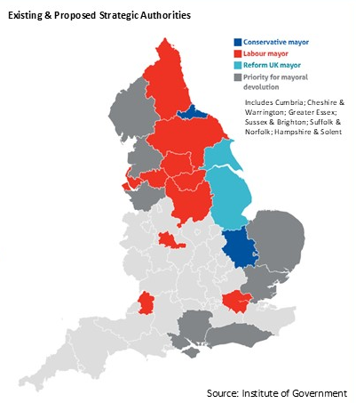
The emerging devolved structure of England
Mayoral Strategic Authorities/GLA
Cambridgeshire & Peterborough
East Midlands
Greater Lincolnshire
Greater Manchester
Hull & East Yorkshire
Liverpool City Region
North East
South Yorkshire
Tees Valley
West of England
West Midlands
West Yorkshire
York and North Yorkshire
Greater London
Non-Mayoral Strategic Authorities
Greater Devon
Lancashire
Devolution Priority Programme for MSAs
Mayoral election May 2027
Cheshire & Warrington Cumbria
Mayoral election May 2028
Greater Essex
Hampshire & Solent
Norfolk/Suffolk
Sussex and Brighton
Existing Devolution Agreements
Buckinghamshire
Council
Cornwall Council
Surrey County
Council
Warwickshire County
Council
Ongoing negotiations in most other parts of England
Further information:
Devolution deals | Local Government Association
Devolution to England | Institute for Government

Slide 9

2026 English Devolution and Community Empowerment Act: Key planning provisions
Planning powers for mayors in England - GOV.UK
STRATEGIC PLANNING RELATED PROVISIONS
Clause 33 (and Schedule 14) – Mayoral powers to call in an application from the Local Planning Authority (and Development Corporations) of potential strategic importance (to be defined in regs).
Clause 34 (and Schedules 15 and 16) – Mayoral powers to establish a Development Order.
Clause 35 (and Schedule 17) – Mayoral powers to raise Community Infrastructure Levy in addition to local CIL.
Clause 36 (and Schedule 18) – land acquisition and development powers for all Strategic Authorities.
Clause 39 – Brownfield land to be prioritised in SDS – to be set out in regs.
Schedule 2 – sets out decision-making for SDS as follows:
Non-mayoral CA/CCA – simple majority vote with each member having one vote.
Mayoral CA/CCA – majority vote but with Mayoral casting vote where there is no clear majority.
[Note SPA voting provisions for non devolved areas is set out in the PIA)

Slide 10
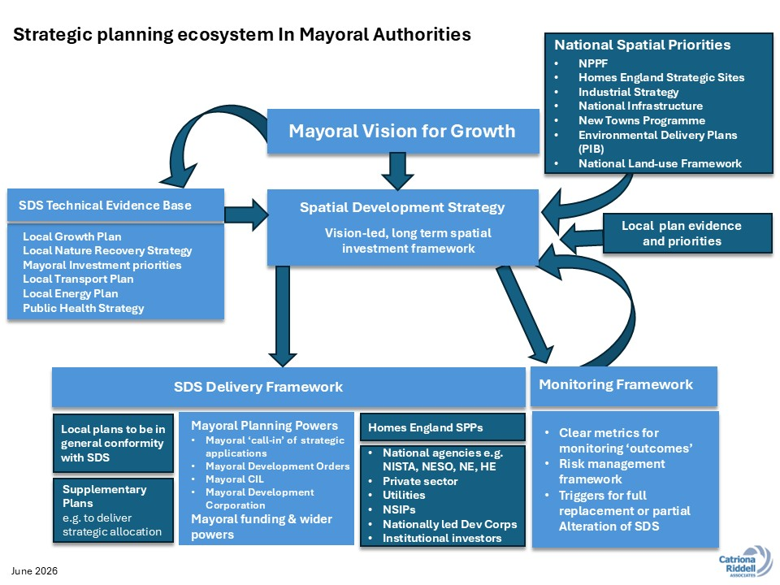
The emerging strategic planning ecosystem
SDS will be part of a wider ecosystem to support long term growth.
MSAs will have much more ability to influence delivery directly due to powers and funding. This will be important at examination when demonstrating credibility of strategy.
Strategic partners will be an essential part of delivery e.g. Homes England SPPs along with LPAs
Other sub-regional plans and strategies will have a key role to play especially LGP but also Local Transport Plan, Local Nature Recovery Strategy.
National plans and strategies will also have a key role to play e.g. the National Infrastructure Plan, National Energy Spatial Plan (and RESPs) – SDS will have to implement these and inform future reviews. Successful delivery will depend on joining up of government departments and agencies –

Slide 11
Planning, LGR & Devolution – How it all fits together
Long term resilient growth
Integrated approach to ‘place’
Local Government Reorganisation
Planning Reform
Devolution
High value placed on the planning service as part of the wider ‘placemaking’ role in supporting ‘good’ growth
Planning & Infrastructure Act
English Devolution & Community Empowerment Bill
A strategic planning ecosystem that integrates shared economic, environmental and infrastructure priorities around ‘place’ fully aligned with local planning priorities
Efficient governance and decision-making systems that prioritises meaningful community and stakeholder involvement while delivering a premium customer experience
Universal requirement to prepare Spatial Development Strategies
Modernising planning committees (including national scheme of delegation
Locally set planning fees
Strategic Development Management and Development Order powers
Land acquisition and development powers
Strategic infrastructure levy (CIL).
Expansion of Mayoral Development Corporation powers
A bridge between national & local policies & priorities
Well resourced planning service that supports continuous learning & development and fosters a happy, creative & safe environment for its staff
Transformational delivery using all devolved tools & funding opportunities to support resilient growth
Faster national infrastructure projects
Innovative approaches to sharing services, expertise & resources, helping to delivery efficiencies of scale and supporting regional centres of excellence
Innovative systems & processes, maximising the potential of digitisation and delivering efficient & faster planning services
Wider Reforms (including LUR Act)
New local plan-making system
National Policies for Decision-Making
Digitisation of planning
Changes to Statutory Consultees
Innovative and efficient local service delivery
POS LGR Resource Hub -POS

Slide 12
What next?
First tranche of funding for SDS has been allocated.
Planning & Infrastructure Act SDS Regulations, final SDS geography, PPG to be published in Autumn.
First Strategic Planning Boards established late Autumn.
First SDS timetables agreed by SoS in the early 2027.
All timing subject to new PM!!
Thank you!
Tel: +44 7710405957
Email: catrionariddell@btinternet.com
Linkedin: Catriona Riddell | LinkedIn

